Slide 1
Graphics Programming

Slide 2
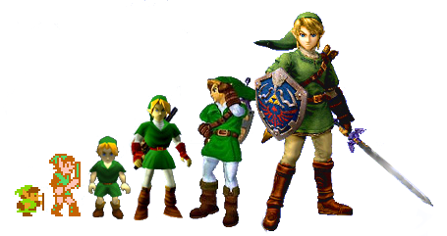
Evolution of Graphics

Slide 3
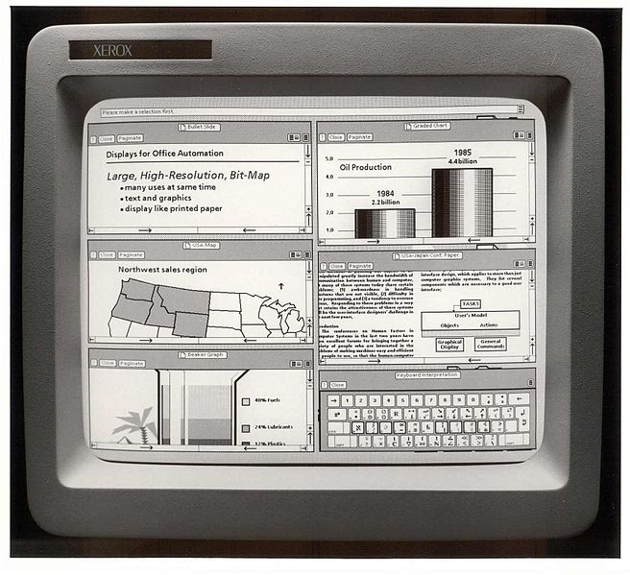
Early GUIs
Draw data to a computer terminal
Foundation of visual operating systems
Color complexity has grown over time:
1-bit (black and white)
2-bit (4 colors)
4-bit (16 colors)
8-bit (256 colors)
24-bit (16,777,216 colors)

Slide 4
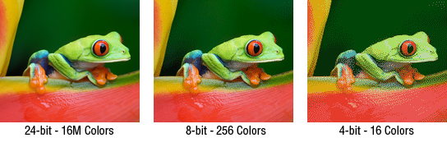
Color Depth Visualized

Slide 5
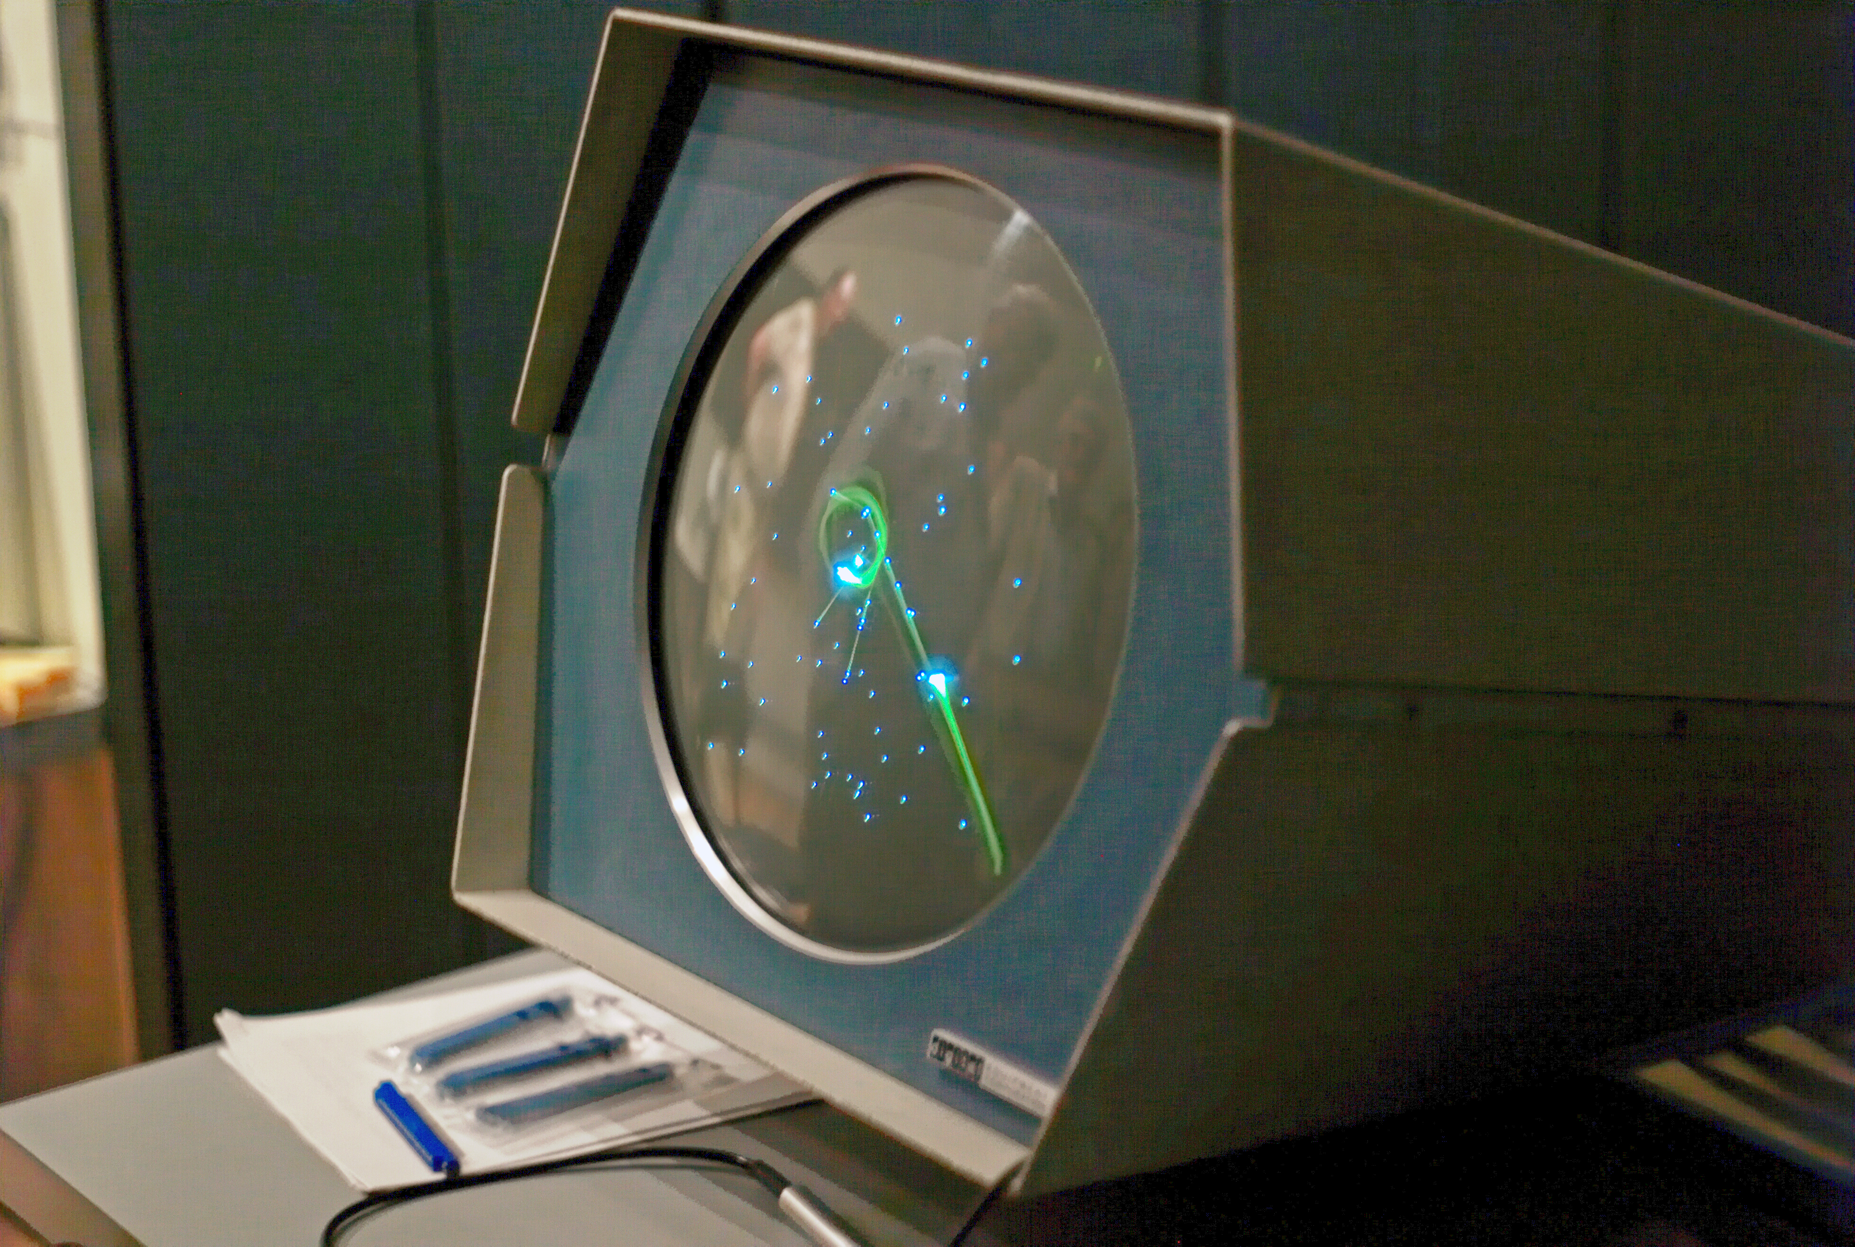
The Start of Computer Gaming
With the advent of GUIs came the start of video games
Spacewar! (pictured) is credited as being one of the earliest video games
Converts user input into a behavior and changes the program accordingly
Updates the display continuously

Slide 6
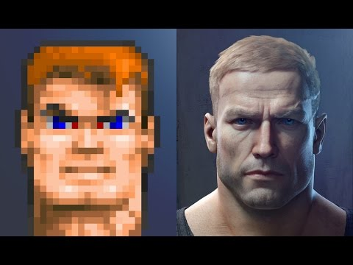
Video Game Graphics
Graphics improvements allow for rendering objects in video games at near photo-realistic qualities
Improvements in modern GPUs allow for processing and rendering of graphics to be done in parallel, resulting in more detailed imagery
For VR, photorealism is one part of immersion experience

Slide 7
3D Scene Design

Slide 8
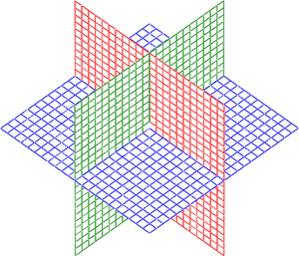

The 3D Coordinate System
Objects within a scene are placed a specific location with an X, Y, and Z value
Each object also has X, Y, and Z properties related to the size of the object: width, height, and depth
For this course, we will talk about Y being the positive upward direction, X being to a viewer’s left or right, and Z being distance from the viewer
Y
X
Z

Slide 9
Scene Objects
Types of potential objects in a scene:
Character / Camera
Lights
Props
Enemies / Non-Player Characters
Environment (Terrain) objects
User interfaces
Whatever you can imagine!

Slide 10
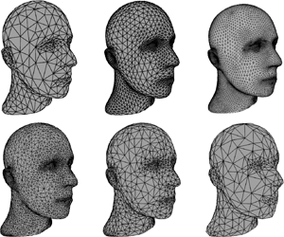
Detailed Mesh Objects
Graphics cards generally render meshes as a series of triangles
More triangles = more detail = more processing power needed

Slide 11
Lighting & Shading
Lighting is a great way to add realism to your scene and give objects more depth to their appearance
More lights = more processing and less performance
Different types of lights give different effects
Reflections, shading, and shadows are generally calculated automatically with modern game engines
Different materials on objects will have different shading effects

Slide 12
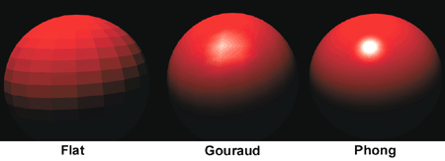

Slide 13
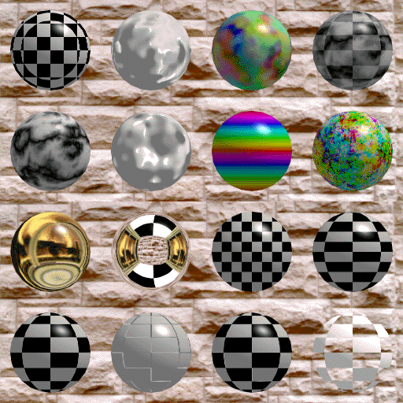
Materials & Textures
Applying different materials to objects can allow you them to take on more detailed appearances without using complex mesh geometry
Textures are materials that can include information about how to render the object
Example: Rocks may have a bumpy surface applied to them to give the appearance of not being smooth

Slide 14
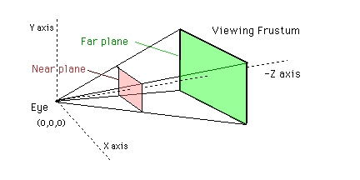
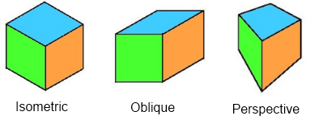
Cameras
Determine what part of the scene is in view
Can change effects based on the type of projection that is set up

Slide 15
Characters
Player Character
Non-Player Character
Controlled by the person in the game
Camera follows
First Person: Camera is through the eyes of the character
Third Person: Camera usually sits above looking down on the character
Enemies or Allies
Program behavior through scripts
Behaviors may change based on user input

Slide 16
Scripts
Code that tells objects how to act in the game
Game Loop: updates every “clock tick” (frame) and checks to see if the behavior of anything in the game scene should change
Commonly written in C#, UnityScript, Boo (Unity), C++ (Unreal), JavaScript (WebVR) for virtual and augmented reality
User Actions
Input
Game loop checks logic and updates code
Game displays new behaviors from script

Slide 17
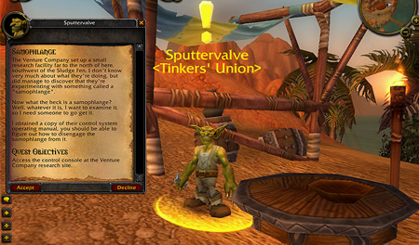
User Interfaces
Present the user with interactions and information
Can be part of the in-game experience (such as with a dialog box) or separate from it (such as with a menu or level selection option)

Slide 18
UI Considerations in Virtual Reality
Text is harder to read when it’s rendered stereoscopically*
Placement in space might not be convenient depending on where the player is facing
Reading may be uncomfortable depending on what is being displayed
Interactive elements (e.g. buttons) need to support various inputs
* Green is the easiest color to read in VR

Slide 19
3D Development Tools

Slide 20
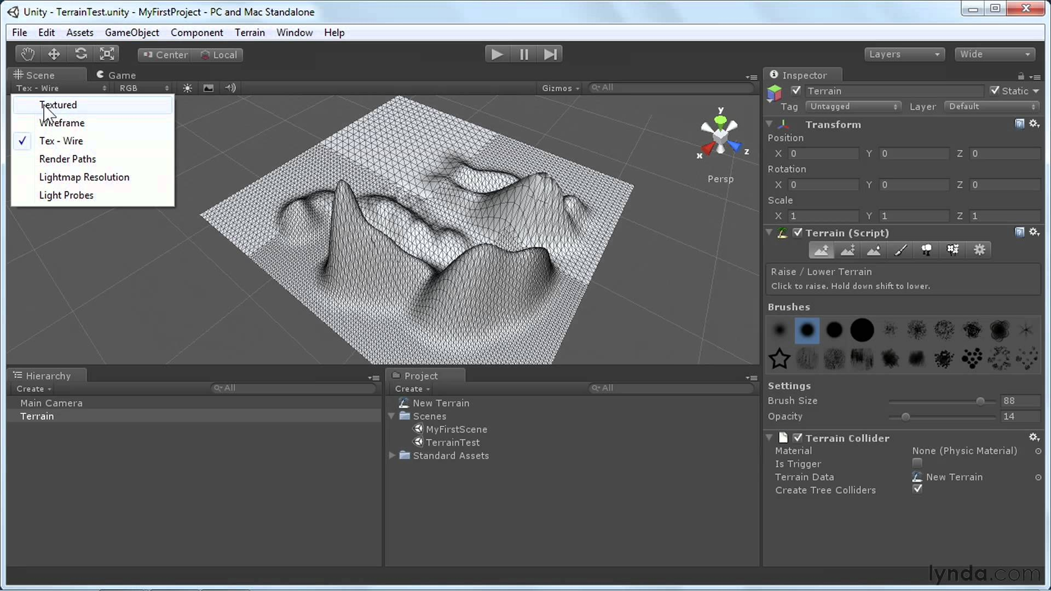
Unity 3D

Slide 21
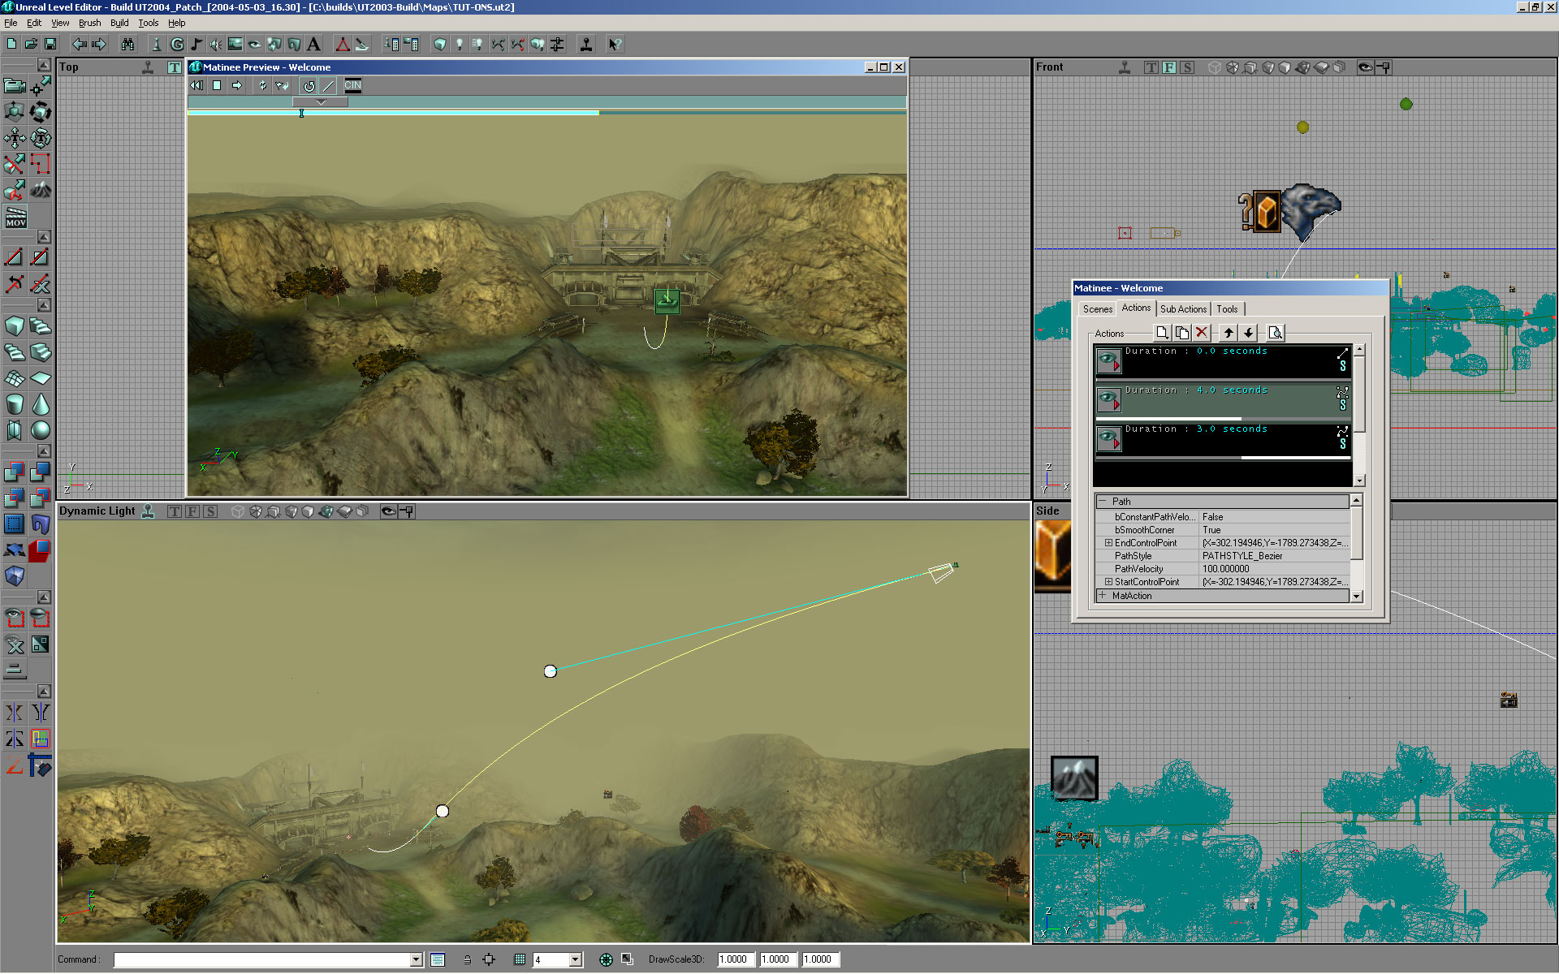
Unreal Engine

Slide 22
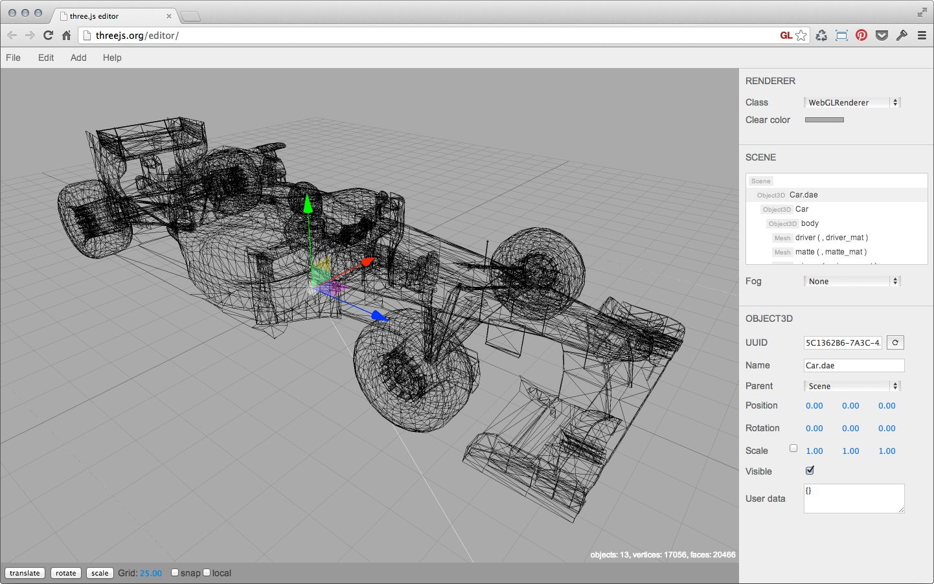
Three.JS Editor

Slide 23
3D Modeling

Slide 24
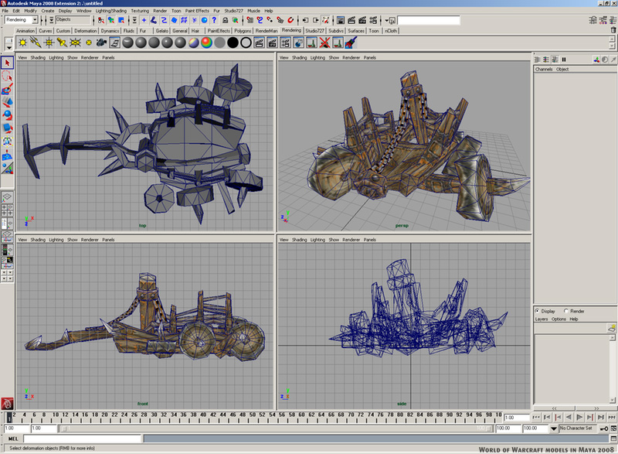
Creating Models
3D models can be built and textured with specialized software:
Maya 3D
Blender
Z-Brush
SketchUp
Models are converted into a file format that can be processed by graphics programs (such as a .obj) file

Slide 25
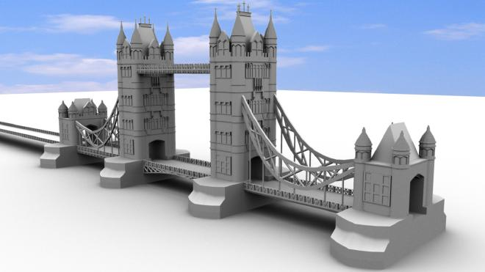
Finding Models
There are many resources for finding 3D models to use in a software application online
Unity and Unreal both have marketplaces where assets for game and app development can be purchased

